Slide 1
LOWER SIXTH ARTS
GEOGRAPHY
Lesson 2
The Climate of Cameroon
Notes:
Good morning, class, and welcome to our geography lesson. I am your geography teacher, Mr Kamdem. Today we are starting Lesson 2: The Climate of Cameroon.

Slide 2
CLASS INFO
Class, Chapter and Duration
Class | Lower Sixth Arts
Chapter | Geography of Cameroon
Duration | 2 periods (2 × 50 minutes)
Notes:
This lesson is for Lower Sixth Arts. It belongs to Geography of Cameroon. We shall need 2 periods to cover it.

Slide 3
IDENTIFICATION
Lesson Identification
Topic | Geography of Cameroon
Sub-topic | The Physical Environment of Cameroon
Lesson | Lesson 2: The Climate of Cameroon
Notions / Concepts | Climate, climatic domain, air mass, Harmattan, monsoon, Intertropical Convergence Zone (ITCZ), continentality, seasons.
Syllabus focus | Location of Cameroon in Africa; major climatic domains and their types (Equatorial: Guinea, Cameroon maritime and mountain types; Tropical continental: humid and dry tropical); temperature, sunshine and precipitation; role of air masses and the ITCZ; seasons and continentality.
Competence | Learners are able to describe the climatic types of Cameroon and explain the role of air masses, the ITCZ and continentality.
Notes:
Our topic is Geography of Cameroon, and the sub-topic is The Physical Environment of Cameroon. The key notions we shall use today are: climate, climatic domain, air mass, Harmattan, monsoon, Intertropical Convergence Zone (ITCZ), continentality, seasons. At the end, you should be able to do this: learners are able to describe the climatic types of Cameroon and explain the role of air masses, the ITCZ and continentality.

Slide 4

HOMEWORK CORRECTION
Correction of the Homework
Question (Lesson 1: Relief of Cameroon):
Name the two air masses that affect the climate of Cameroon.
Notes:
Before we start the new lesson, let us correct the homework I gave you at the end of Lesson 1: Relief of Cameroon. The question was: Name the two air masses that affect the climate of Cameroon. Take out your exercise books.

Slide 5
HOMEWORK CORRECTION
Correction: Possible Answer
The dry North-East Trade Wind (Harmattan) from the Sahara, and the moist South-West Monsoon from the Atlantic Ocean.
Notes:
Here is a good answer. The dry North-East Trade Wind (Harmattan) from the Sahara, and the moist South-West Monsoon from the Atlantic Ocean. Compare it with your own answer and correct your work in red.

Slide 6
LESSON PLAN
Lesson Plan
Correction of the homework
Objectives and recall
Real-life situation and action to take
Learning activities
Board summary
Evaluation, remediation and homework
Notes:
Here is the plan of our lesson today. First, we shall correct the homework. Then we shall look at the objectives and recall what you already know. After that, we shall study a situation from real life and the action to take, and do the learning activities. Finally, we shall copy the board summary, do the evaluation and the remediation, and I will give you the homework.

Slide 7
OBJECTIVES
Objectives
By the end of this lesson, you should be able to:
Locate Cameroon and situate it in Africa.
Describe the role of air masses and the ITCZ.
Notes:
Take your time to copy this part; we will continue together.

Slide 8
OBJECTIVES
Objectives (continued)
Describe the types of climate of the Equatorial domain.
Describe the types of climate of the Tropical continental domain.
Explain the variation of seasons with continentality.
Notes:
By the end of this lesson, you should be able to do five things. Number 1: locate Cameroon and situate it in Africa. Number 2: describe the role of air masses and the ITCZ. Number 3: describe the types of climate of the Equatorial domain. Number 4: describe the types of climate of the Tropical continental domain. Number 5: explain the variation of seasons with continentality.

Slide 9
PREVIOUS KNOWLEDGE
Previous Knowledge
Climate is the average weather of a place over about 30 years.
Garoua has a wet season and a long dry season.
The Harmattan is a dry, dusty wind.
Notes:
Let us first remember what you already know. Climate is the average weather of a place over about 30 years. Garoua has a wet season and a long dry season. The Harmattan is a dry, dusty wind. Keep this in mind, because we shall build on it today.

Slide 10
REAL-LIFE SITUATION
Situation in Real Life
In January your cousin from Kribi visits Garoua.
The air is full of Harmattan dust, the sun is burning and the Benue is almost dry.
He asks: "Does it ever rain here?"
Notes:
Take your time to copy this part; we will continue together.

Slide 11
REAL-LIFE SITUATION
Situation in Real Life (continued)
You tell him to come back in August, when the land is green and the rain is heavy.
He then asks: "Why is the climate of Garoua so different from the climate of Kribi?"
Notes:
Listen carefully to this situation from real life. In January your cousin from Kribi visits Garoua. The air is full of Harmattan dust, the sun is burning and the Benue is almost dry. He asks: "Does it ever rain here?" You tell him to come back in August, when the land is green and the rain is heavy. He then asks: "Why is the climate of Garoua so different from the climate of Kribi?" Think about it, because I am going to ask you some questions.

Slide 12
REAL-LIFE SITUATION
Situation: Question 1
What is the problem in the situation?
Notes:
Question 1: What is the problem in the situation? Think for a moment, then raise your hand to answer.

Slide 13
REAL-LIFE SITUATION
Answer
The cousin does not understand why the climates of Garoua and Kribi are so different.
Notes:
Good. The cousin does not understand why the climates of Garoua and Kribi are so different.

Slide 14
REAL-LIFE SITUATION
Situation: Question 2
How is the weather of Garoua in January?
Notes:
Question 2: How is the weather of Garoua in January? Think for a moment, then raise your hand to answer.

Slide 15
REAL-LIFE SITUATION
Answer
Hot, dry and dusty, with the Harmattan.
Notes:
Good. Hot, dry and dusty, with the Harmattan.

Slide 16
REAL-LIFE SITUATION
Situation: Question 3
When does Garoua have its rain?
Notes:
Question 3: When does Garoua have its rain? Think for a moment, then raise your hand to answer.

Slide 17
REAL-LIFE SITUATION
Possible Answer
In the wet season, mainly from May to September.
Notes:
Good. In the wet season, mainly from May to September.

Slide 18
ACTION TO TAKE
Action to Take
Plan farming and daily activities according to the seasons of your region.
Notes:
From this situation, the action we are working towards in this lesson is the following: plan farming and daily activities according to the seasons of your region.

Slide 19
JUSTIFICATION
Justification of the Lesson
This lesson helps us to understand the climates of Cameroon, which control farming calendars, water supply and the way of life in each region.
Notes:
Why is this lesson important for you? This lesson helps us to understand the climates of Cameroon, which control farming calendars, water supply and the way of life in each region.

Slide 20

1. LOCATION
Activity 1
Cameroon with its latitudes.
Notes:
Activity 1. Look carefully at this diagram: cameroon with its latitudes. Observe every detail before I ask the question.

Slide 21
1. LOCATION
Activity 1: Question
Between which latitudes does Cameroon stretch?
Notes:
Here is the question for Activity 1: Between which latitudes does Cameroon stretch? Take one minute to think and write your answer in your rough notebook.

Slide 22
1. LOCATION
Activity 1: Answer
From about 2° N to 13° N.
Notes:
Let us check the answer together. From about 2° N to 13° N.

Slide 23

2. AIR MASSES AND THE ITCZ
Activity 2
Animation: the rain belt moves during the year.
Notes:
Activity 2. Look carefully at this animation: animation: the rain belt moves during the year. Watch the animation to the end; it will play again.

Slide 24
2. AIR MASSES AND THE ITCZ
Activity 2: Question
Which wind brings rain to Garoua in July?
Notes:
Here is the question for Activity 2: Which wind brings rain to Garoua in July? Take one minute to think and write your answer in your rough notebook.

Slide 25
2. AIR MASSES AND THE ITCZ
Activity 2: Answer
The moist South-West Monsoon from the Atlantic.
Notes:
Let us check the answer together. The moist South-West Monsoon from the Atlantic.

Slide 26

3. EQUATORIAL DOMAIN
Activity 3
The climate of Douala.
Notes:
Activity 3. Look carefully at this diagram: the climate of Douala. Observe every detail before I ask the question.

Slide 27
3. EQUATORIAL DOMAIN
Activity 3: Question
Why does Douala receive so much rain?
Notes:
Here is the question for Activity 3: Why does Douala receive so much rain? Take one minute to think and write your answer in your rough notebook.

Slide 28
3. EQUATORIAL DOMAIN
Activity 3: Answer
It is on the coast, where moist monsoon air is forced to rise over the land and Mount Cameroon.
Notes:
Let us check the answer together. It is on the coast, where moist monsoon air is forced to rise over the land and Mount Cameroon.

Slide 29

4. TROPICAL CONTINENTAL DOMAIN
Activity 4
The climate of Garoua.
Notes:
Activity 4. Look carefully at this diagram: the climate of Garoua. Observe every detail before I ask the question.

Slide 30
4. TROPICAL CONTINENTAL DOMAIN
Activity 4: Question
How many months of rain does Garoua have?
Notes:
Here is the question for Activity 4: How many months of rain does Garoua have? Take one minute to think and write your answer in your rough notebook.

Slide 31
4. TROPICAL CONTINENTAL DOMAIN
Activity 4: Answer
About five months (May to September).
Notes:
Let us check the answer together. About five months (May to September).

Slide 32
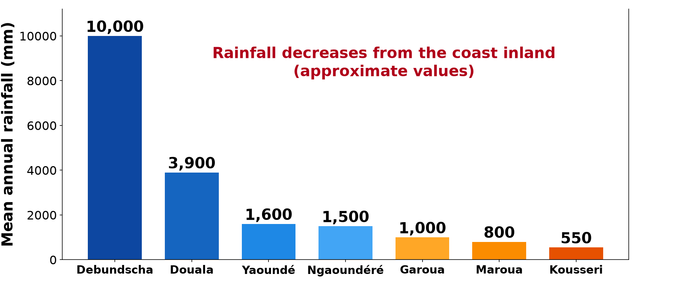
5. SEASONS AND CONTINENTALITY
Activity 5
Rainfall of some towns of Cameroon.
Notes:
Activity 5. Look carefully at this diagram: rainfall of some towns of Cameroon. Observe every detail before I ask the question.

Slide 33
5. SEASONS AND CONTINENTALITY
Activity 5: Question
How does the rainfall change from Douala to Kousseri?
Notes:
Here is the question for Activity 5: How does the rainfall change from Douala to Kousseri? Take one minute to think and write your answer in your rough notebook.

Slide 34
5. SEASONS AND CONTINENTALITY
Activity 5: Answer
It decreases steadily from the coast inland.
Notes:
Let us check the answer together. It decreases steadily from the coast inland.

Slide 35
BOARD SUMMARY
Board Summary
Topic: Geography of Cameroon
Sub-topic: The Physical Environment of Cameroon
Lesson 2: The Climate of Cameroon
Notes:
Now we are going to copy the board summary. Write the title and the headings neatly in your notebooks. I will give you enough time for each slide, so do not rush.

Slide 36
BOARD SUMMARY
DEFINITIONS
The key terms of this lesson are defined as follows:
Climate: It is the average state of the weather of a place over a long period, usually 30 years.
Notes:
Let us copy the definitions. The key terms of this lesson are defined as follows. On this slide we have Climate. Write each point on a new line, with the key term first, and explain it in your own words when we revise. When you finish, we go to the next slide.

Slide 37
BOARD SUMMARY
DEFINITIONS (continued)
Climatic domain: It is a large region with the same general climate, divided into types of climate.
Air mass: It is a very large body of air with nearly the same temperature and humidity.
Notes:
We continue with the definitions. On this slide we have Climatic domain and Air mass. Write each point on a new line, with the key term first, and explain it in your own words when we revise. When you finish, we go to the next slide.

Slide 38
BOARD SUMMARY
DEFINITIONS (continued)
Intertropical Convergence Zone (ITCZ): It is the zone where the dry north-east trade winds and the moist south-west monsoon meet; its surface line is the Intertropical Front (ITF).
Notes:
We continue with the definitions. On this slide we have Intertropical Convergence Zone (ITCZ). Write each point on a new line, with the key term first, and explain it in your own words when we revise. When you finish, we go to the next slide.

Slide 39
BOARD SUMMARY
DEFINITIONS (continued)
Continentality: It is the effect of distance from the sea on climate: rainfall decreases and temperature range increases inland.
Notes:
We continue with the definitions. On this slide we have Continentality. Write each point on a new line, with the key term first, and explain it in your own words when we revise.

Slide 40
BOARD SUMMARY
1. Location of Cameroon in Africa
The location of Cameroon and its consequence on climate are the following:
Latitudes: It stretches from about 2° N to 13° N, about 1,200 km from south to north.
Illustration: Cameroon and its latitudes
Notes:
Let us copy Location of Cameroon in Africa. The location of Cameroon and its consequence on climate are the following. Copy the point on Latitudes on the left, then draw the diagram on the right: cameroon and its latitudes. Give it a title and label it clearly.

Slide 41
BOARD SUMMARY
1. Location of Cameroon in Africa
Longitudes: It lies between about 8° E and 16° E.
Position in Africa: It is in Central Africa, at the bend of the Gulf of Guinea, with an area of about 475,000 km².
Notes:
We continue with Location of Cameroon in Africa. On this slide we have Longitudes and Position in Africa. Write each point on a new line, with the key term first, and explain it in your own words when we revise. When you finish, we go to the next slide.

Slide 42
BOARD SUMMARY
1. Location of Cameroon in Africa (continued)
Consequence: Its great length from the equatorial south to the Sahel north gives it very varied climates.
Notes:
We continue with Location of Cameroon in Africa. On this slide we have Consequence. Write each point on a new line, with the key term first, and explain it in your own words when we revise.

Slide 43
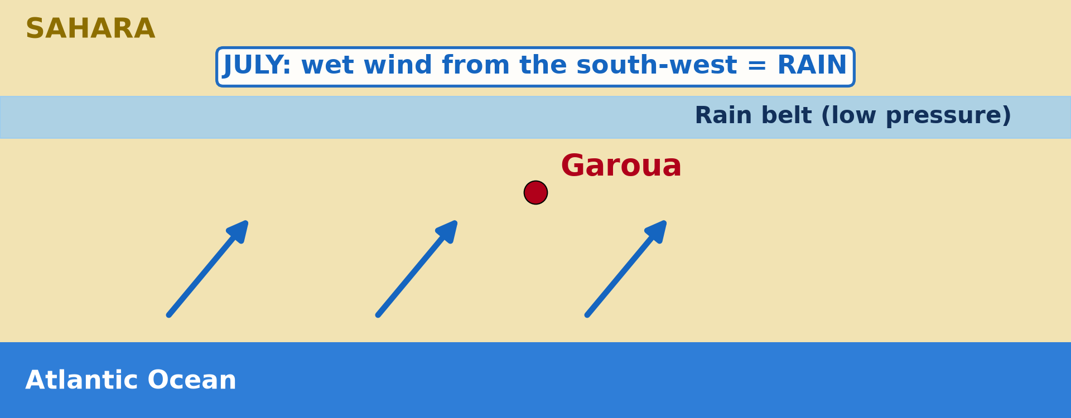
BOARD SUMMARY
2. The Role of Air Masses and the ITCZ
The air masses, the ITCZ and their effect on the climate of Cameroon are the following:
The South-West Monsoon: It is a tropical maritime air mass from the Atlantic Ocean, warm and very moist, that brings the rainy season.
Illustration: the south-west monsoon in July
Notes:
Let us copy The Role of Air Masses and the ITCZ. The air masses, the ITCZ and their effect on the climate of Cameroon are the following. Copy the point on The South-West Monsoon on the left, then draw the diagram on the right: the south-west monsoon in July. Give it a title and label it clearly.

Slide 44

BOARD SUMMARY
2. The Role of Air Masses and the ITCZ
The Harmattan: It is the north-east trade wind, a tropical continental air mass from the Sahara, hot by day, very dry and dusty, that brings the dry season.
Illustration: Harmattan dust
Notes:
Copy the point on The Harmattan on the left, then draw the diagram on the right: harmattan dust. Give it a title and label it clearly.

Slide 45
BOARD SUMMARY
2. The Role of Air Masses and the ITCZ
The ITCZ: It moves north and south with the overhead sun: in July–August it lies north of Cameroon, and in January it lies near the coast.
Effect: Places south of the ITF are in the monsoon and get rain, while places north of it are in the Harmattan and are dry.
Notes:
We continue with The Role of Air Masses and the ITCZ. On this slide we have The ITCZ and Effect. Write each point on a new line, with the key term first, and explain it in your own words when we revise.

Slide 46

BOARD SUMMARY
3. The Equatorial Domain
A) The Guinea (Equatorial) Type
The location and characteristics of the Guinea type are the following:
Location: It covers the Southern Plateau, for example Yaoundé, Ebolowa and Bertoua.
Illustration: the climate of Yaoundé
Notes:
Let us copy The Guinea (Equatorial) Type. The location and characteristics of the Guinea type are the following. Copy the point on Location on the left, then draw the diagram on the right: the climate of Yaoundé. Give it a title and label it clearly.

Slide 47
BOARD SUMMARY
3. The Equatorial Domain
A) The Guinea (Equatorial) Type
Temperature: It is hot all year (about 23–25 °C), with a small annual range of 2–3 °C.
Rainfall: It receives about 1,500–2,000 mm per year (about 1,600 mm at Yaoundé).
Four seasons:
A long dry season (December–February).
Notes:
We continue with The Guinea (Equatorial) Type. On this slide we have Temperature, Rainfall and Four seasons. Write each point on a new line, with the key term first, and explain it in your own words when we revise. When you finish, we go to the next slide.

Slide 48
BOARD SUMMARY
3. The Equatorial Domain
A) The Guinea (Equatorial) Type (continued)
A short rainy season (March–June).
A short dry season (July–August).
A long rainy season (September–November).
Sunshine: The sky is often cloudy, so sunshine is moderate.
Notes:
We continue with The Guinea (Equatorial) Type. On this slide we have Sunshine. Write each point on a new line, with the key term first, and explain it in your own words when we revise.

Slide 49
BOARD SUMMARY
3. The Equatorial Domain
B) The Cameroon (Maritime) Type
The location and characteristics of the Cameroon maritime type are the following:
Location: It covers the coast and the seaward slopes of Mount Cameroon, for example Douala, Limbe, Kribi and Debundscha.
Illustration: the climate of Douala
Notes:
Let us copy The Cameroon (Maritime) Type. The location and characteristics of the Cameroon maritime type are the following. Copy the point on Location on the left, then draw the diagram on the right: the climate of Douala. Give it a title and label it clearly.

Slide 50
BOARD SUMMARY
3. The Equatorial Domain
B) The Cameroon (Maritime) Type
Very heavy rainfall: Rainfall is 2,500 to 10,000 mm per year: about 4,000 mm at Douala and about 10,000 mm at Debundscha, one of the wettest places in the world.
Notes:
We continue with The Cameroon (Maritime) Type. On this slide we have Very heavy rainfall. Write each point on a new line, with the key term first, and explain it in your own words when we revise. When you finish, we go to the next slide.

Slide 51
BOARD SUMMARY
3. The Equatorial Domain
B) The Cameroon (Maritime) Type (continued)
Two seasons: A long rainy season (March–November) and a short dry season (December–February).
Temperature and humidity: It is hot (about 26–27 °C) and very humid all year, with little sunshine.
Notes:
We continue with The Cameroon (Maritime) Type. On this slide we have Two seasons and Temperature and humidity. Write each point on a new line, with the key term first, and explain it in your own words when we revise.

Slide 52

BOARD SUMMARY
3. The Equatorial Domain
C) The Mountain Type
The location and characteristics of the mountain type are the following:
Location: It covers the Western Highlands, for example Bamenda, Dschang and Buea.
Illustration: the Bamenda Highlands
Notes:
Let us copy The Mountain Type. The location and characteristics of the mountain type are the following. Copy the point on Location on the left, then draw the diagram on the right: the Bamenda Highlands. Give it a title and label it clearly.

Slide 53
BOARD SUMMARY
3. The Equatorial Domain
C) The Mountain Type
Cool temperatures: Temperature falls by about 0.6 °C every 100 m, so the highlands are cool (about 18–21 °C).
Rainfall: Rainfall is high on windward slopes (often above 2,000 mm) and lower on sheltered slopes.
Notes:
We continue with The Mountain Type. On this slide we have Cool temperatures and Rainfall. Write each point on a new line, with the key term first, and explain it in your own words when we revise. When you finish, we go to the next slide.

Slide 54
BOARD SUMMARY
3. The Equatorial Domain
C) The Mountain Type (continued)
Mist and cold nights: Mist, fog and cold nights are common in the rainy season.
Notes:
We continue with The Mountain Type. On this slide we have Mist and cold nights. Write each point on a new line, with the key term first, and explain it in your own words when we revise.

Slide 55
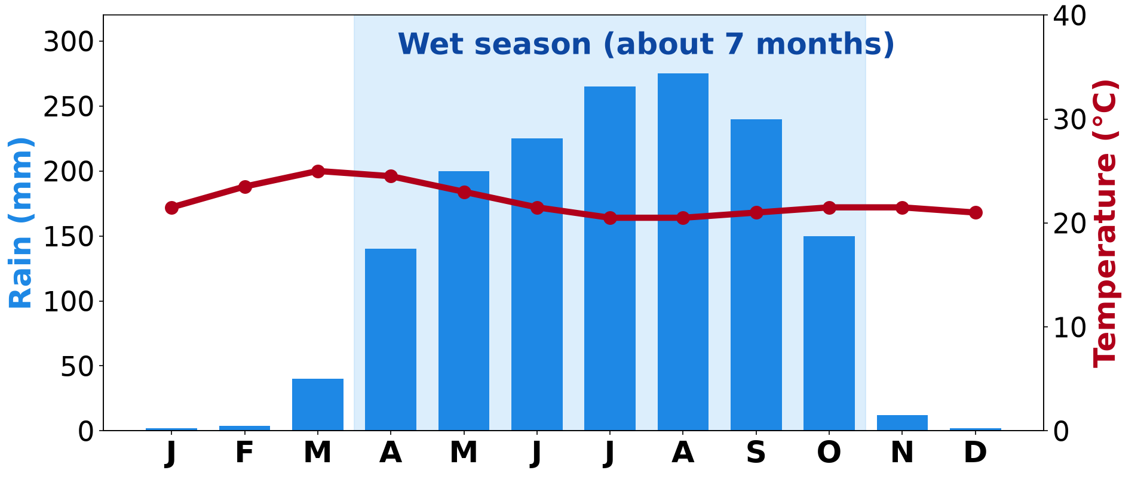
BOARD SUMMARY
4. The Tropical Continental Domain
A) The Humid Tropical (Sudan) Type
The location and characteristics of the humid tropical type are the following:
Location: It covers the Adamawa Plateau and the north of the Centre and East, for example Ngaoundéré.
Illustration: the climate of Ngaoundéré
Notes:
Let us copy The Humid Tropical (Sudan) Type. The location and characteristics of the humid tropical type are the following. Copy the point on Location on the left, then draw the diagram on the right: the climate of Ngaoundéré. Give it a title and label it clearly.

Slide 56
BOARD SUMMARY
4. The Tropical Continental Domain
A) The Humid Tropical (Sudan) Type
Two seasons: A rainy season of about 7 months (April–October) and a dry season of about 5 months.
Rainfall: It receives about 1,500 mm per year.
Notes:
We continue with The Humid Tropical (Sudan) Type. On this slide we have Two seasons and Rainfall. Write each point on a new line, with the key term first, and explain it in your own words when we revise. When you finish, we go to the next slide.

Slide 57
BOARD SUMMARY
4. The Tropical Continental Domain
A) The Humid Tropical (Sudan) Type (continued)
Temperature: Altitude keeps it mild (about 22 °C), with cool Harmattan nights.
Notes:
We continue with The Humid Tropical (Sudan) Type. On this slide we have Temperature. Write each point on a new line, with the key term first, and explain it in your own words when we revise.

Slide 58
BOARD SUMMARY
4. The Tropical Continental Domain
B) The Dry Tropical (Sudano-Sahelian) Type
The location and characteristics of the dry tropical type are the following:
Location: It covers the North and Far North Regions, for example Garoua, Maroua and Kousseri.
Illustration: the climate of Garoua
Notes:
Let us copy The Dry Tropical (Sudano-Sahelian) Type. The location and characteristics of the dry tropical type are the following. Copy the point on Location on the left, then draw the diagram on the right: the climate of Garoua. Give it a title and label it clearly.

Slide 59
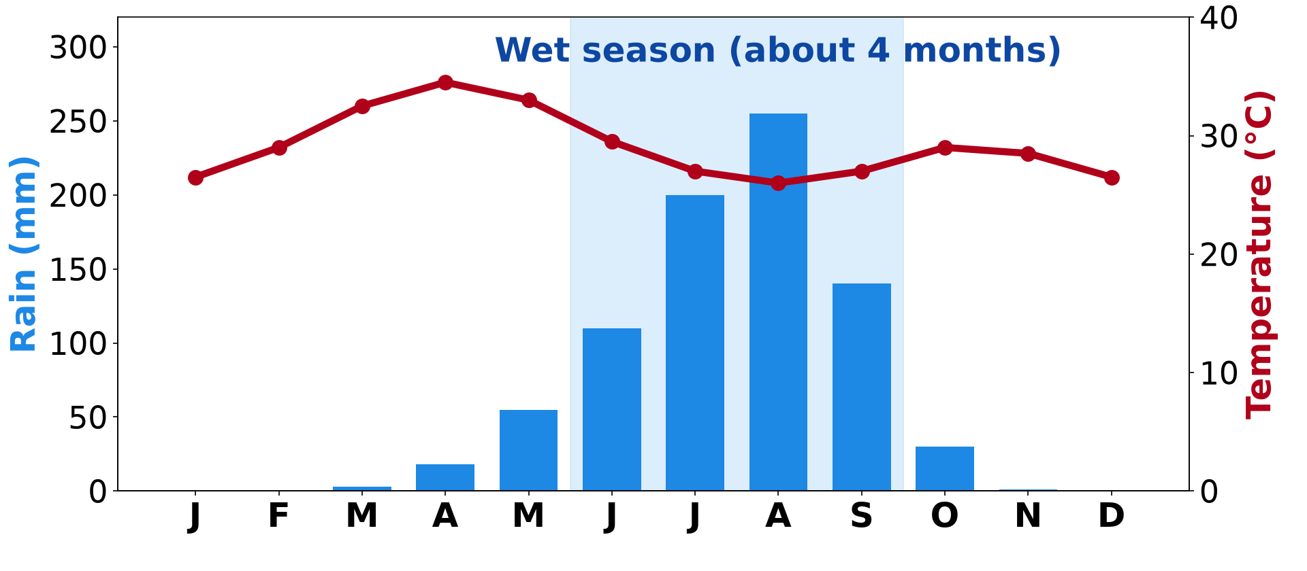
BOARD SUMMARY
4. The Tropical Continental Domain
B) The Dry Tropical (Sudano-Sahelian) Type
Short rainy season: The rainy season lasts 3 to 5 months: about 5 months at Garoua and about 4 months at Maroua.
Illustration: the climate of Maroua
Notes:
Copy the point on Short rainy season on the left, then draw the diagram on the right: the climate of Maroua. Give it a title and label it clearly.

Slide 60
BOARD SUMMARY
4. The Tropical Continental Domain
B) The Dry Tropical (Sudano-Sahelian) Type
Low rainfall: Rainfall falls northwards from about 1,000 mm at Garoua to about 800 mm at Maroua and about 550 mm at Kousseri.
High temperatures: It is very hot, with maxima above 40 °C in March–April and a larger annual range than in the south.
Notes:
We continue with The Dry Tropical (Sudano-Sahelian) Type. On this slide we have Low rainfall and High temperatures. Write each point on a new line, with the key term first, and explain it in your own words when we revise. When you finish, we go to the next slide.

Slide 61
BOARD SUMMARY
4. The Tropical Continental Domain
B) The Dry Tropical (Sudano-Sahelian) Type (continued)
Long dry season and sunshine: The dry season lasts 7 to 9 months, with the Harmattan, low humidity and a lot of sunshine.
Notes:
We continue with The Dry Tropical (Sudano-Sahelian) Type. On this slide we have Long dry season and sunshine. Write each point on a new line, with the key term first, and explain it in your own words when we revise.

Slide 62
BOARD SUMMARY
5. The Seasons and Continentality
The variations of the seasons with distance from the coast are the following:
Rainfall decreases inland: Annual rainfall falls from about 10,000 mm at Debundscha to about 550 mm at Kousseri.
Illustration: rainfall of some towns of Cameroon
Notes:
Let us copy The Seasons and Continentality. The variations of the seasons with distance from the coast are the following. Copy the point on Rainfall decreases inland on the left, then draw the diagram on the right: rainfall of some towns of Cameroon. Give it a title and label it clearly.

Slide 63
BOARD SUMMARY
5. The Seasons and Continentality
Shorter rainy season: The monsoon reaches the north later and leaves it earlier, so the rainy season becomes shorter northwards.
Fewer seasons: The south has four seasons, while the centre and north have only two.
Notes:
We continue with The Seasons and Continentality. On this slide we have Shorter rainy season and Fewer seasons. Write each point on a new line, with the key term first, and explain it in your own words when we revise. When you finish, we go to the next slide.

Slide 64
BOARD SUMMARY
5. The Seasons and Continentality (continued)
Larger temperature range: Far from the sea, the difference between the hottest and the coolest months becomes larger.
Notes:
We continue with The Seasons and Continentality. On this slide we have Larger temperature range. Write each point on a new line, with the key term first, and explain it in your own words when we revise.

Slide 65
FORMATIVE EVALUATION
Evaluation 1
Name the three types of climate of the Equatorial domain in Cameroon.
Notes:
Now let us check what you have understood. Question 1: Name the three types of climate of the Equatorial domain in Cameroon. Answer in your exercise book.

Slide 66
FORMATIVE EVALUATION
Expected Answer
The Guinea type, the Cameroon maritime type and the mountain type.
Notes:
The expected answer is: the Guinea type, the Cameroon maritime type and the mountain type. If you got it right, well done.

Slide 67
FORMATIVE EVALUATION
Evaluation 2
Why is the rainy season shorter at Maroua than at Ngaoundéré?
Notes:
Now let us check what you have understood. Question 2: Why is the rainy season shorter at Maroua than at Ngaoundéré? Answer in your exercise book.

Slide 68
FORMATIVE EVALUATION
Expected Answer
Maroua is farther from the sea: the monsoon reaches it later and leaves it earlier (continentality).
Notes:
The expected answer is: maroua is farther from the sea: the monsoon reaches it later and leaves it earlier (continentality). If you got it right, well done.

Slide 69
REMEDIATION
Remediation
Fill in the blanks:
The dry, dusty wind from the Sahara is the ______.
The wettest place in Cameroon is ______.
The zone where the monsoon and the Harmattan meet is the ______.
Notes:
For those who need more practice, fill in the blanks in your exercise book. The answers are: number 1, Harmattan; number 2, Debundscha; number 3, ITCZ (Intertropical Convergence Zone).

Slide 70
HOMEWORK
Homework
Name the three groups of soils studied in Cameroon.
Notes:
For your homework: Name the three groups of soils studied in Cameroon. We shall correct it at the beginning of our next lesson.

Slide 71
NEXT LESSON
Next Lesson
Our next lesson will be on:
Lesson 3: Soils of Cameroon
Notes:
Our next lesson will be on Lesson 3: Soils of Cameroon. Thank you for your attention, and see you next time.

Slide 72
BILINGUAL GAME
Bilingual Game (Jeu Bilingue)
English | Français
Climate | Le climat
Season | La saison
Air mass | La masse d'air
Monsoon | La mousson
Rainfall | Les précipitations
Humidity | L'humidité
Continentality | La continentalité
Intertropical Front | Le front intertropical
Notes:
Let us play the bilingual game. I say a word in English, and you give me the French word. Then we do the reverse.

Slide 73
LOGBOOK
Official Logbook (1/2)
Module / Topic | Geography of Cameroon
Lesson Title | Lesson 2: The Climate of Cameroon
Expected Learning Outcomes | Locate Cameroon and situate it in Africa. Describe the role of air masses and the ITCZ. Describe the types of climate of the Equatorial domain. Describe the types of climate of the Tropical continental domain. Explain the variation of seasons with continentality.
Competence | Learners are able to describe the climatic types of Cameroon and explain the role of air masses, the ITCZ and continentality.
Notes:
I record this information in the official logbook of the class after the lesson.

Slide 74
LOGBOOK
Official Logbook (2/2)
Matter Taught | DEFINITIONS; Location of Cameroon in Africa; The Role of Air Masses and the ITCZ; The Guinea (Equatorial) Type; The Cameroon (Maritime) Type; The Mountain Type; The Humid Tropical (Sudan) Type; The Dry Tropical (Sudano-Sahelian) Type; The Seasons and Continentality.
Evaluation | Formative evaluation and remediation exercise.
Homework | Name the three groups of soils studied in Cameroon.
Enrolment / Present / Absent | ____ / ____ / ____
Achievement | To be completed after the lesson.
Notes:
I complete the second page of the logbook: the matter taught, the evaluation, the homework and the attendance.

Slide 75
TEACHER'S NOTE
Teacher's Note
Timing: Homework correction, plan, objectives 8 min | Recall, situation, action 10 min | 5 activities 30 min | Board summary (copying) 30 min | Evaluation, remediation 10 min | Homework, next lesson 5 min | Logbook 7 min
Activity 2 is an animation (GIF): it plays automatically in slide-show mode.
Without the projector (Activity 1): draw the latitudes on a sketch map.
Without the projector (Activity 2): draw the two winds meeting.
Without the projector (Activity 3): write Douala's rainfall on the board.
Without the projector (Activity 4): count the wet months on the graph.
Without the projector (Activity 5): write the rainfall of the towns in a column.
Notes:
This slide is for me, the teacher: it gives the timing of the lesson and what to do if the projector is not available.

Slide 76
REFERENCES
References
Geography Syllabus for Sixth Forms (Lower and Upper Sixth), MINESEC, 2019 — Geography of Cameroon.
Teacher's course notes: Mr KAMDEM E., Cameroon Geography (LSA), GBHS Garoua, 2026.
Photo, board summary (The Harmattan): “Bamenda sob a poeira do Harmattan” by carlosoliveirareis, CC BY-NC-SA 2.0, via Flickr (https://www.flickr.com/photos/54218923@N00/387054136)
Photo, board summary (Location): “Bamenda, Cameroon” by jbdodane, CC BY-NC 2.0, via Flickr (https://www.flickr.com/photos/27998473@N02/11293877215)
Diagrams and animations: drawn for this lesson (Geography Department).
Notes:
These are the references and picture credits used to prepare this lesson.

